Slide 1
AIRLINE RESERVATION
Preethi Prative -3122 22 5001 098
Ram Prasath P -3122 22 5001 103
Samyuktha D – 3122 22 5001 309

Slide 2
OBJECTIVE
User Authentication
Passenger Booking
Reservation Tracking:
The Airline Reservation System is a console-based Java application managing airline operations and passenger bookings. The system facilitates user authentication, enables airlines to add flights, allows passengers to book flights and view reservations, and ensures data persistence through file handling. It provides a simple and efficient interface for users to interact with the airline services. The project aims to streamline the process of flight booking and management for both airlines and passengers.

Slide 3
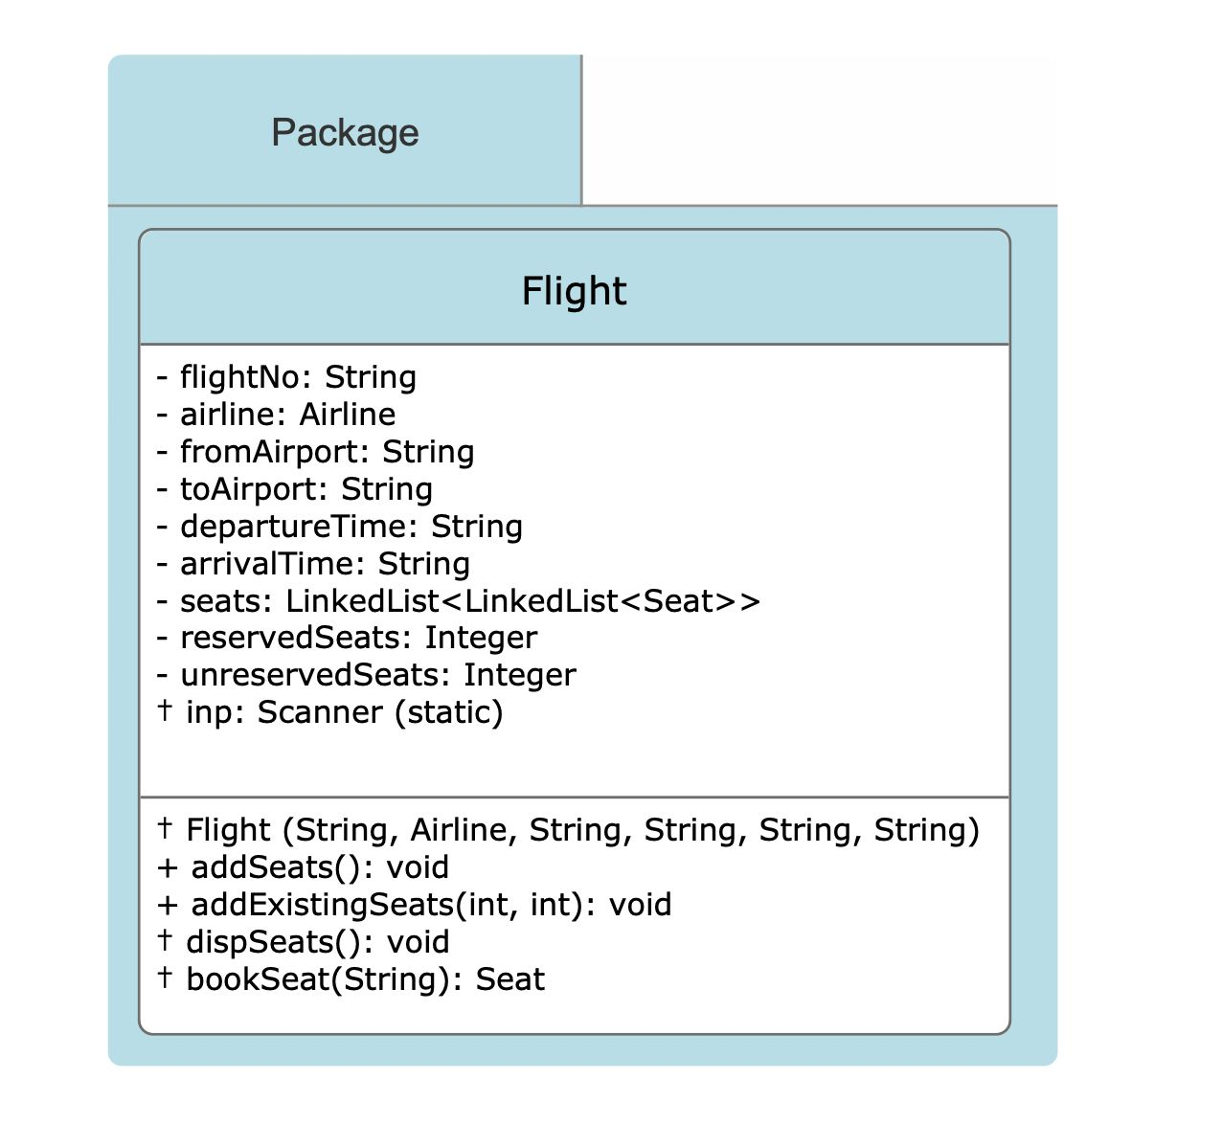
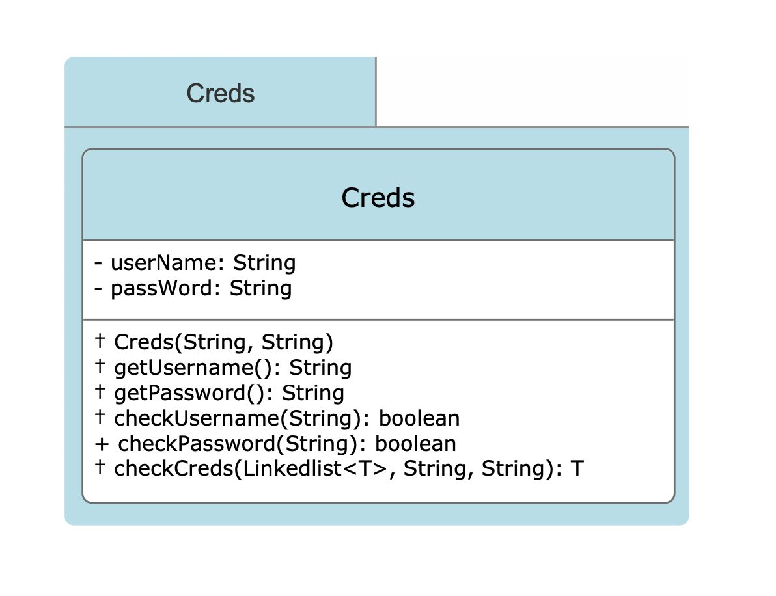
CLASS DIAGRAM

Slide 4
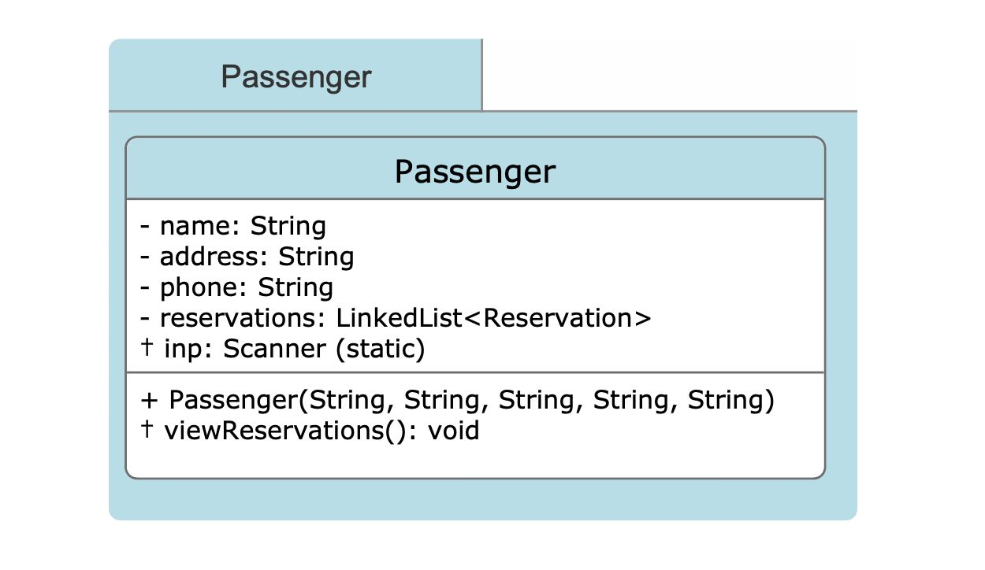

Slide 5
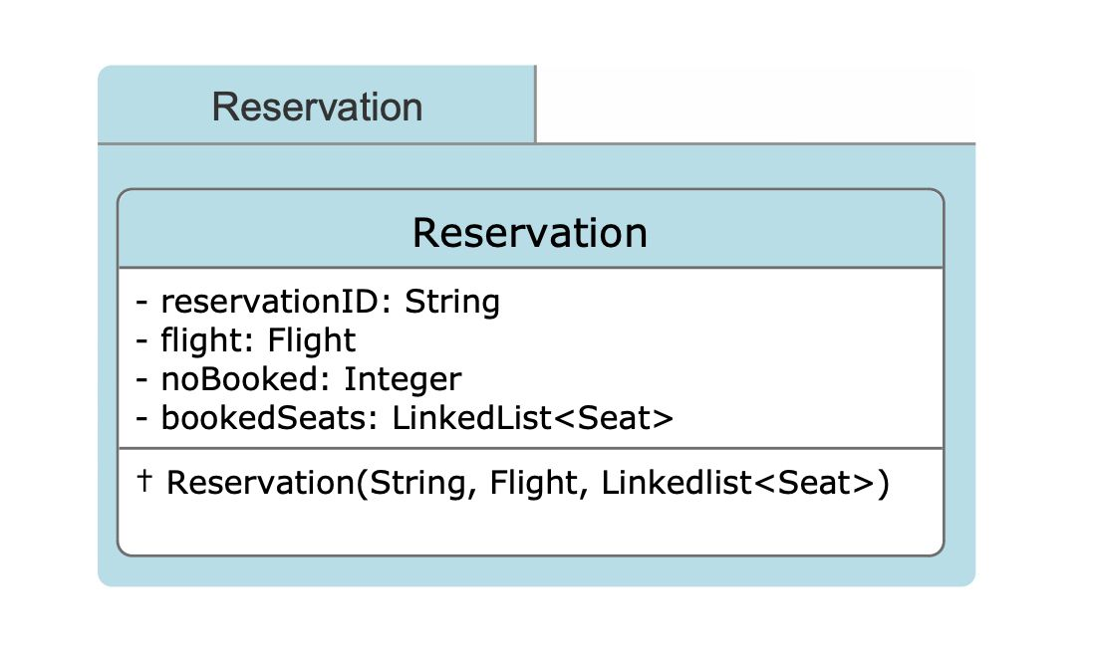
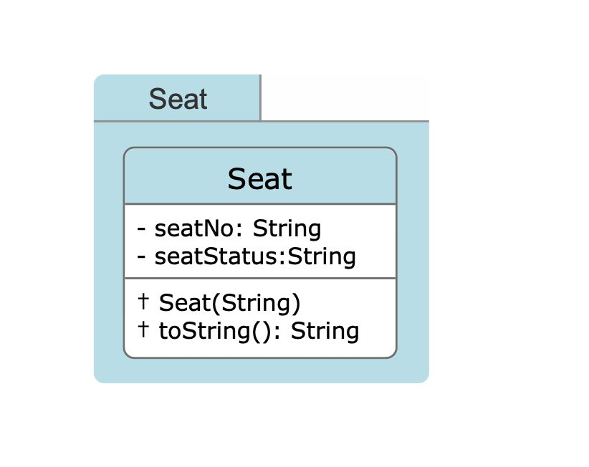

Slide 6
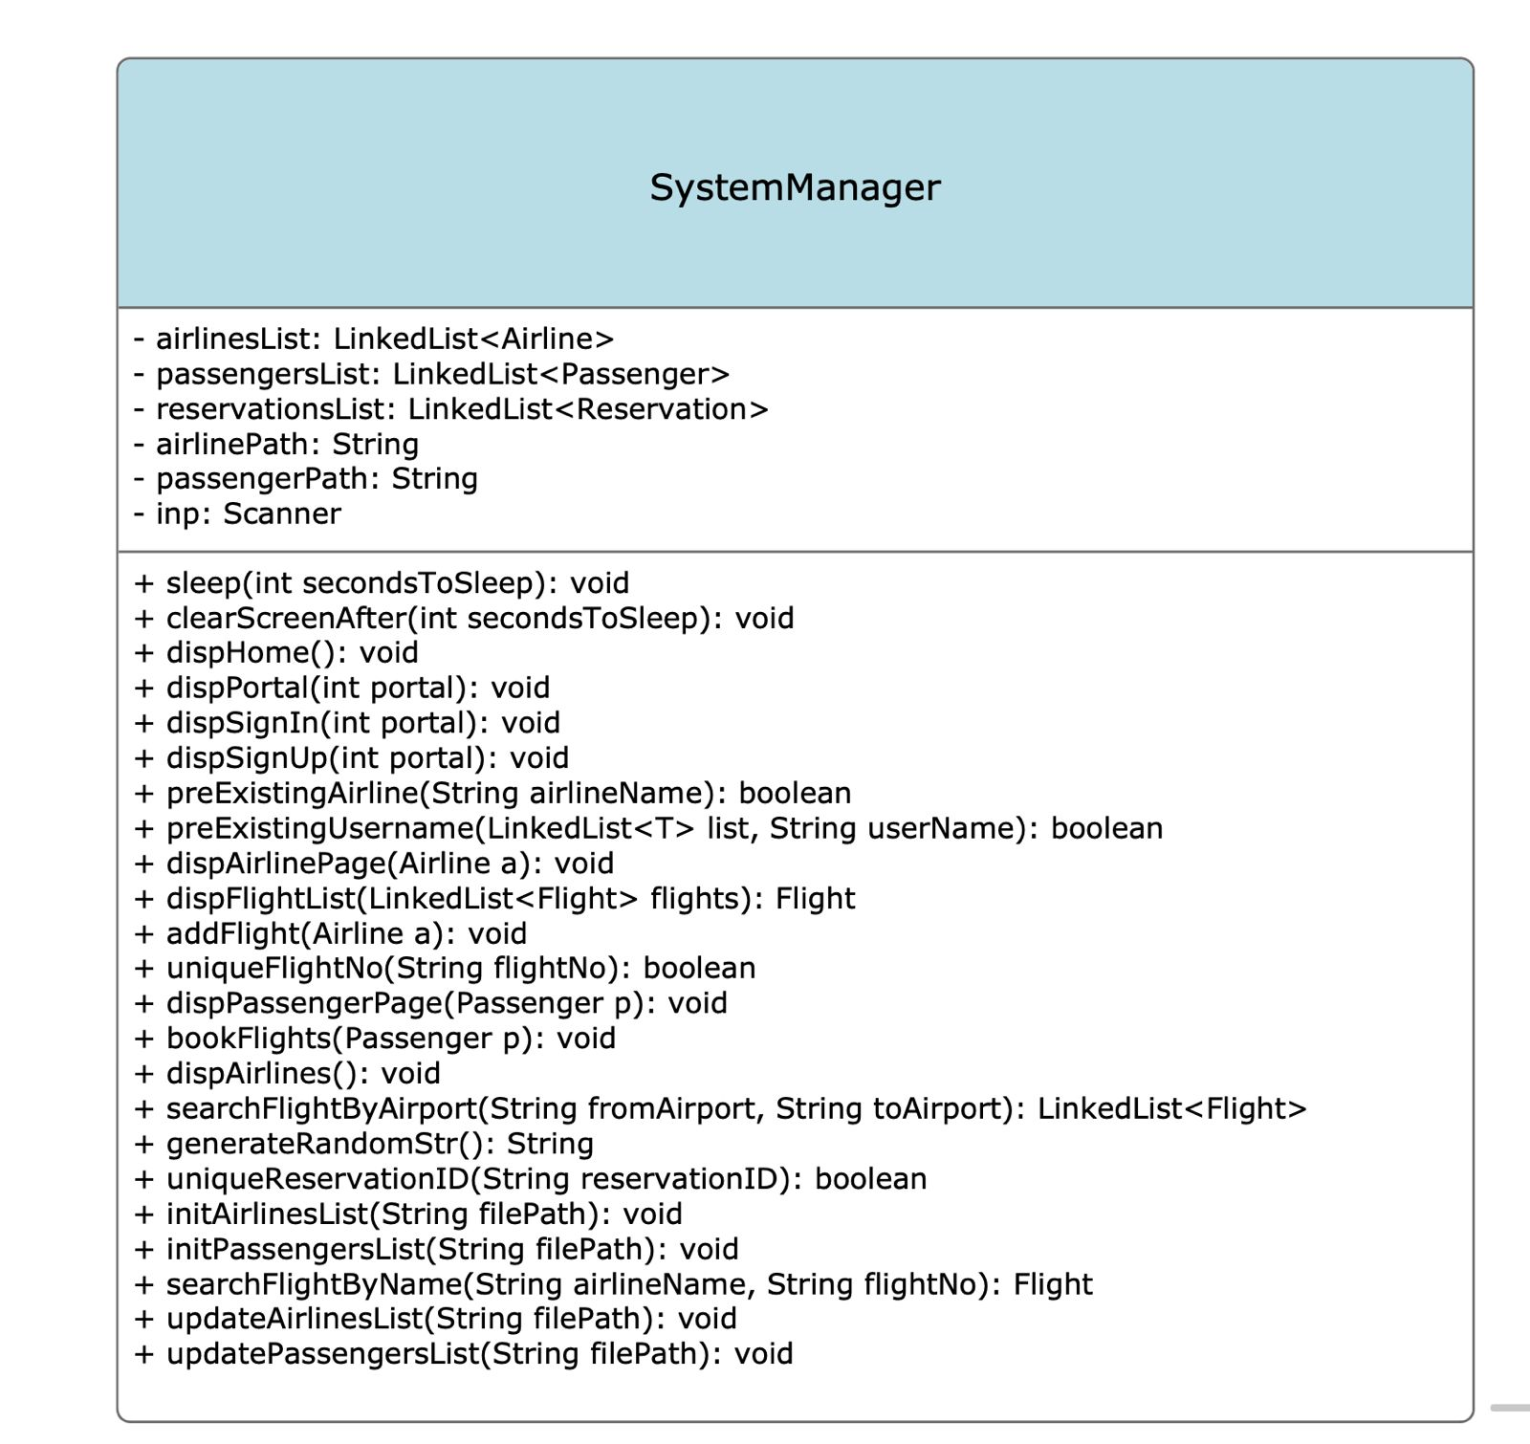

Slide 7
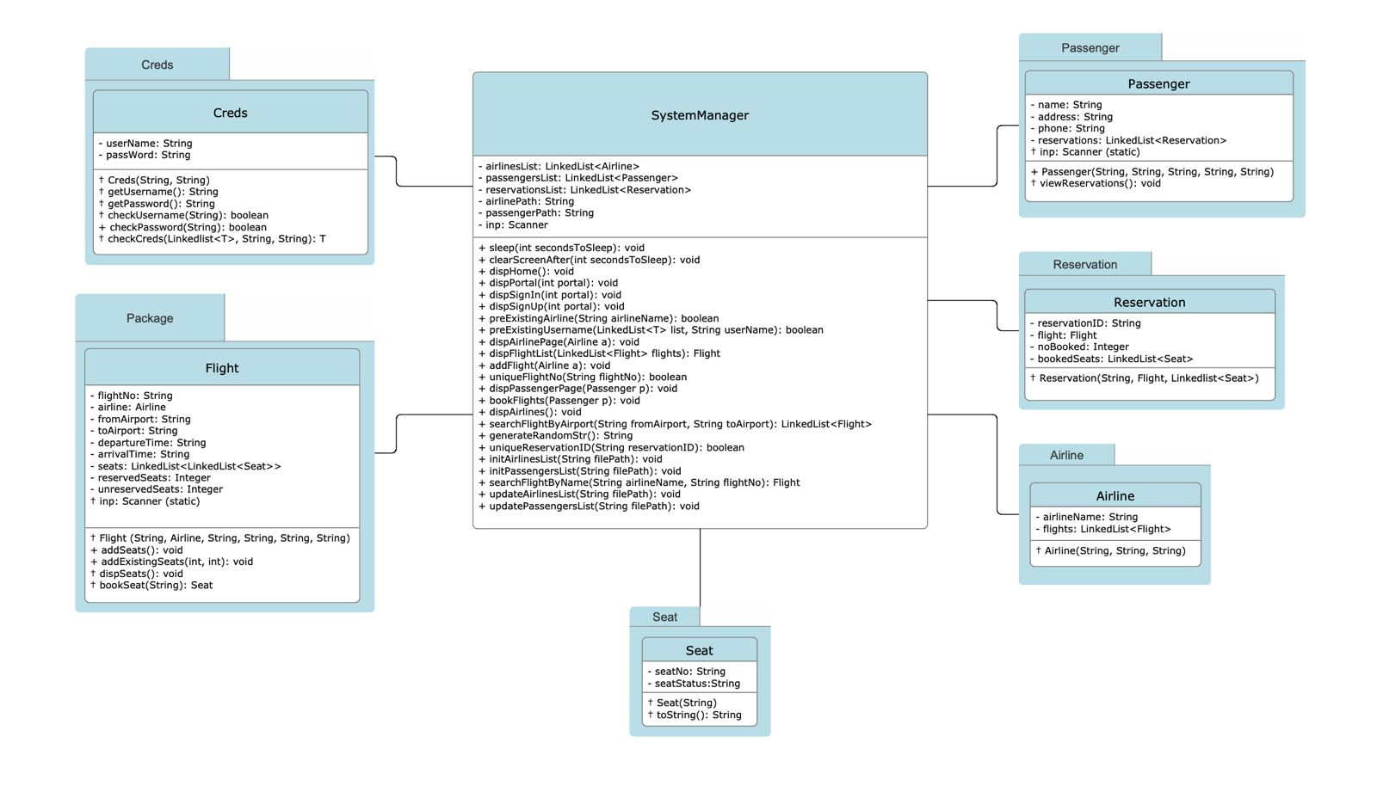

Slide 8
CLASS USED:
Airline
Creds
Flight
Passenger
Reservation
Seat
SystemManager

Slide 9
SystemManager:
The central module managing the overall system.
Responsible for initializing, updating, and interacting with airlines, passengers, and reservations.
Creds:
Provides credential-checking functionality for both airlines and passengers during sign-in.
Airline:
Represents an airline entity, including details such as name, username, password, and a list of associated flights.
Passenger:
Represents a passenger entity, storing information like name, address, phone, username, password, and a list of reservations.
Flight:
Represents a flight entity, containing details like flight number, airline, departure, and arrival information, as well as a list of seats.
Seat:
Represents a seat entity within a flight, including a seat number and reservation status.
Reservation:
Represents a reservation entity, linking a passenger to a specific flight and a set of booked seats.

Slide 10
File Handling:
Includes methods to initialize and update data by reading from and writing to external files.
User Interface:
Manages the console-based user interface, handling user input, displaying menus, and providing feedback.

Slide 11
OOPs CONCEPTS USED:
Inheritance
Data abstraction
Encapsulation
Dynamic binding
Packages
Exception Handling
File Handling
Collections

Slide 12
THANK YOU

